Slide 1

Game Management
The Difference Between Good and Great

Slide 2
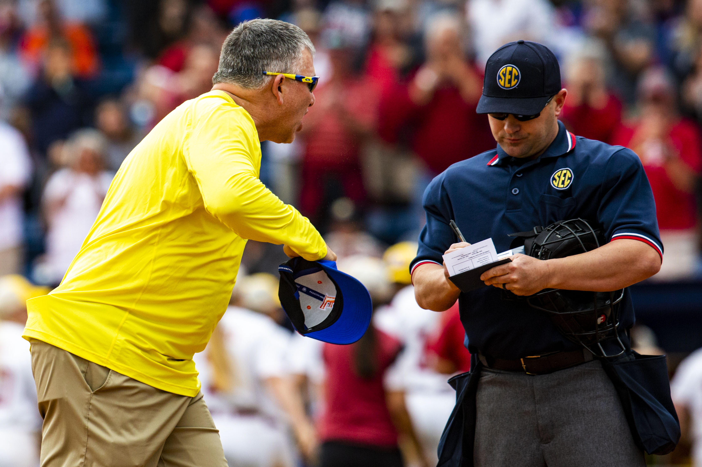
Rough Day at the Office?

Slide 3
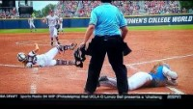
Case Study In Managing the Game

Slide 4
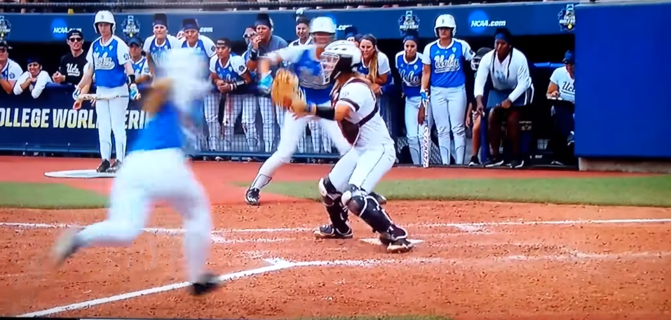
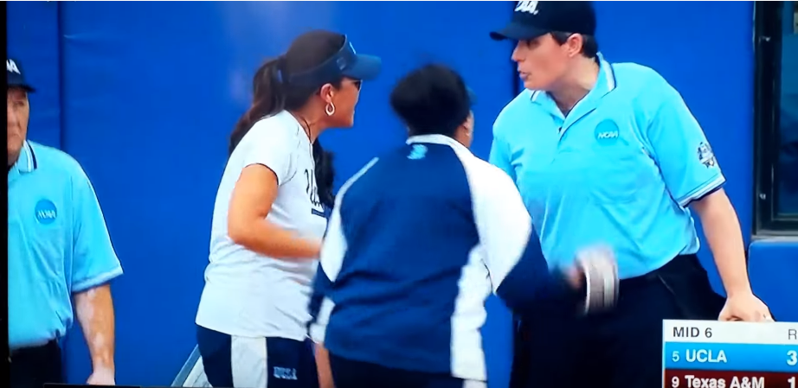
Game Management Overview
Definition
What it is and what it looks like.
How it is developed
How it is maintained
How it is refined
“Facilitator vs Dictator”
Professional Actions and Appearance
Communications…Verbal and Non-Verbal
Preventative Umpiring
Experience
Pre-Game
Sportsmanship
Game Time, Post Game

Slide 5
Successful Umpires
“Successful umpires have certain common qualities.” They include:
Effective game management
Self control
A current knowledge of rules and
mechanics
Notes:
In our USA Softball Umpire Manual, pages…..###, Successful umpires….

Slide 6
What is Game Management?
Game management is;
Good game management and attention to detail are ways to prevent unexpected things from happening in a game. Beyond the calling of outs and safes, it is the manner in which you approach all of the other situations that may occur in a game, which is very important. Umpires need to listen and address all game issues in a professional manner.
Game Administration: Establish and maintain an appropriate game pace. When asked a question by a coach, listen to the question and respond to it in a respectful way.
Sportsmanship: It is important that we have a clear understanding of the expectations for good sportsmanship. If a coach or any game personnel exhibits poor sportsmanship it is your responsibility to address the issue.
Notes:
Ask the question, what is game management & get about 1 minute of feedback and either say what is on the slide or have one of the participants read it.

Slide 7
What is Game Management?
Game management is;
Sportsmanship (cont): If the behavior warrants a warning, then it is your responsibility to make certain the crew is aware when a warning is issued and the reason for the warning. If there is an ejection, follow the protocol for the ejection and continuing the game.
On the Field: Partner communication is extremely important. Umpire-to-umpire signals and verbal communication are two methods umpires use to convey information. Work as a team and communicate with each other. Know your responsibilities as well as your partner.
Hustle: An umpire’s movement on the field, at all times, should be brisk, purposeful, educated and appropriate. Move to your next position by choosing the efficient path to achieve optimum position for all possible situations.
Notes:
Ask the question, what is game management & get about 1 minute of feedback and either say what is on the slide or have one of the participants read it.

Slide 8
What is Game Management?
Game management is;
Line–up Cards: Good line-up card management begins at the pregame conference with the coaches and captains. When a change occurs in the line-up, confirm the change before giving it to the opposing coach and the scorekeeper. This will alleviate any possible line-up change protests. Take your time.
Before you accept any change, look to make sure that the pitcher has the ball in the pitcher’s circle and then call time to accept the change.
Use common sense and preventative umpiring when appropriate: When possible be proactive in preventing violations. If a coach is about to take their fourth charged defensive conference in the game, make sure they know they previously used one, which could prevent the removal of the pitcher (3-7-1 penalty)
Notes:
Ask the question, what is game management & get about 1 minute of feedback and either say what is on the slide or have one of the participants read it.

Slide 9
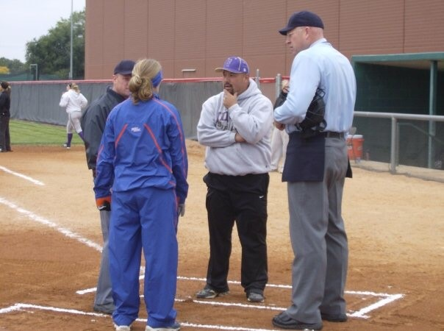
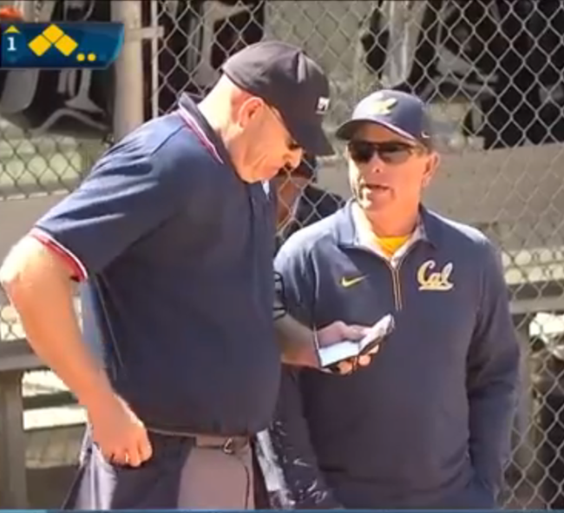
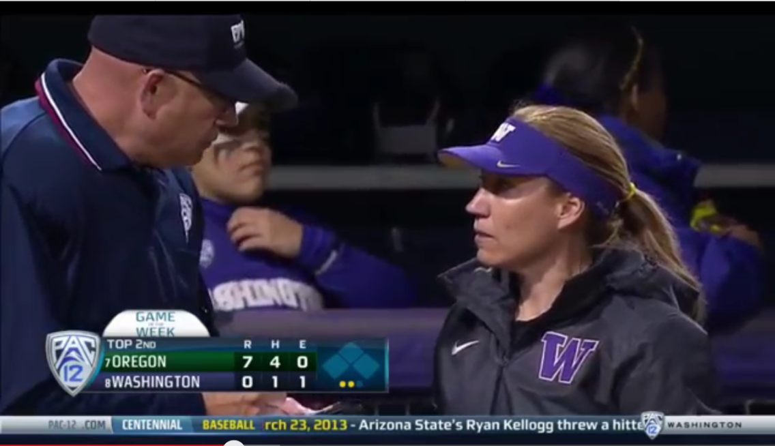
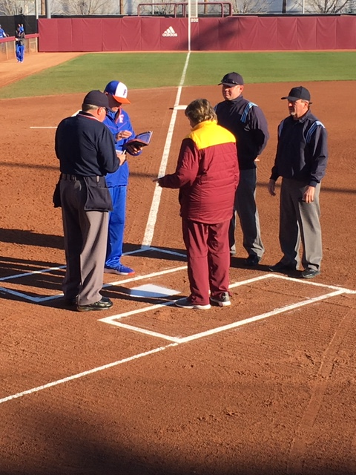
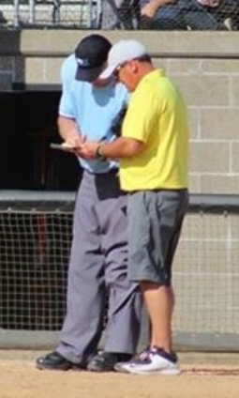
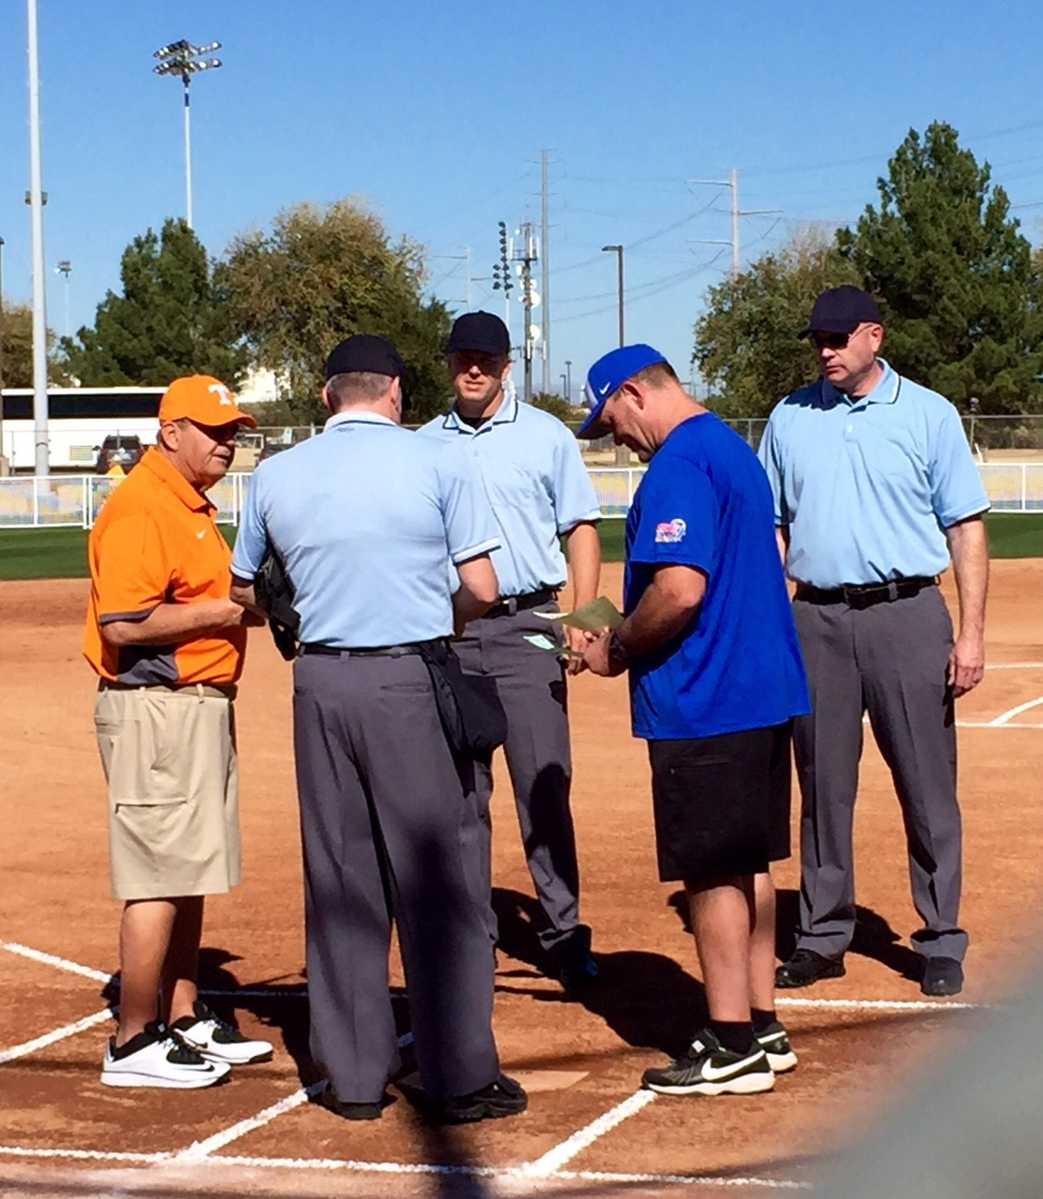
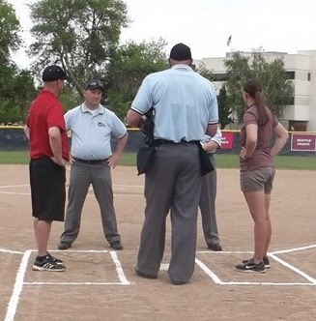
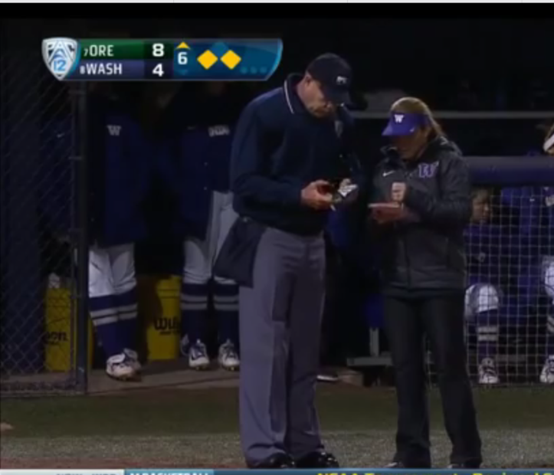
What is Game Management?
Notes:
Ask the question, what is game management & get about 1 minute of feedback and either say what is on the slide or have one of the participants read it.

Slide 10
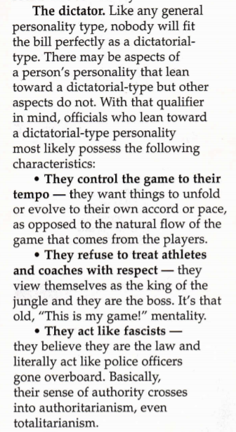
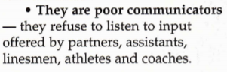
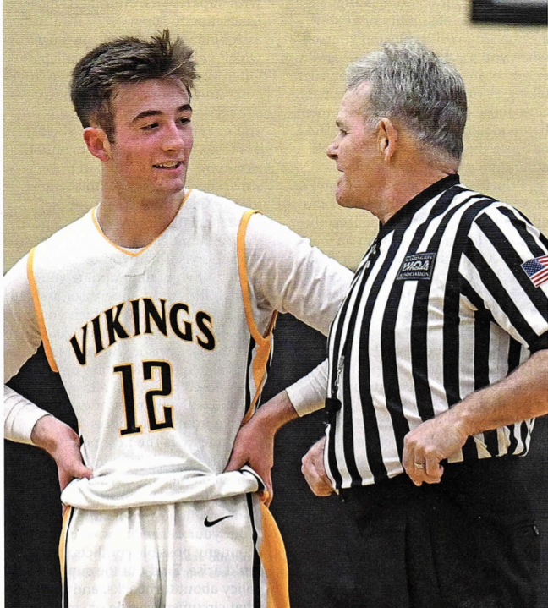
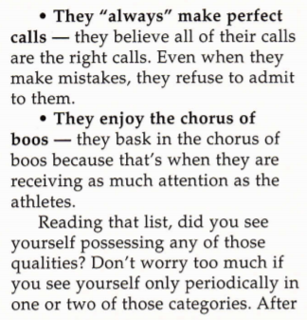
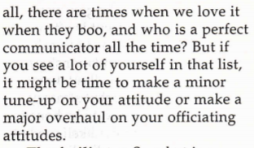
Facilitator vs Dictator

Slide 11
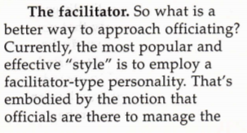
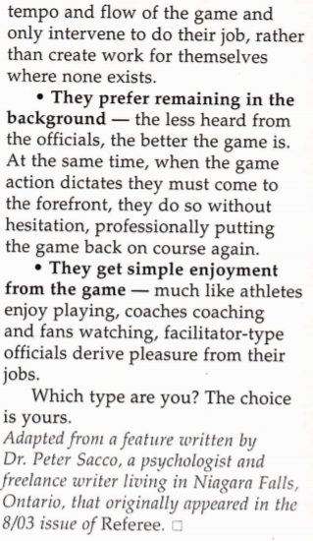
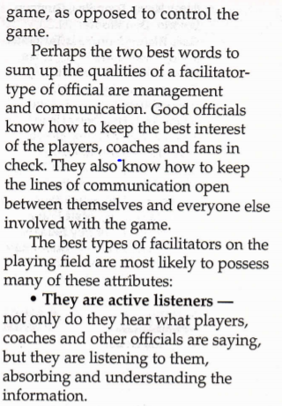
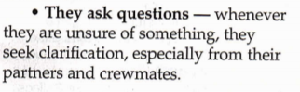
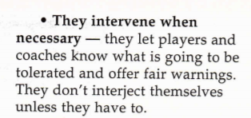
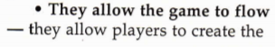
Facilitator vs Dictator

Slide 12
Elements of Successful Game Management?
Professionalism & Professional Appearance;
Is the level of skill, competence, good judgment and respectful behavior that defines excellence in an umpire.
Professionalism starts with proper knowledge, application, and understanding of the intent of our playing rules, and philosophies of our mechanics.
Using proper signals that are clear, distinct, and meaningful,
Notes:
Ask the question, what is professionalism & professional appearance have to do with GM & get about 1 minute of feedback and either say what is on the slide or have one of the participants read it.

Slide 13
Elements of Successful Game Management?
Communication;
Communication is the verbal or nonverbal exchange of opinions, rulings and information using signals, mechanics, behavior, and body language. There are two aspects to effective communication: speaking as well as listening.
The art of communication is a balance between knowing when to listen and how to effectively respond. Umpires should resist the temptation to monopolize the conversation.
Notes:
Ask the question, what does communication have to do with GM & get about 1 minute of feedback and either say what is on the slide or have one of the participants read it.

Slide 14
Elements of Successful Game Management?
Communication;
Keep an open mind; it is not necessary to have the last word. Before you speak make sure the person talking has an opportunity to state their viewpoint.
Do not anticipate your reply; be sure you hear and understand what the other person has to say. By truly listening to a coach or player, we can better address the situation in a positive manner
Notes:
Continue to have a student read. This allows them to stay engaged and participate.

Slide 15
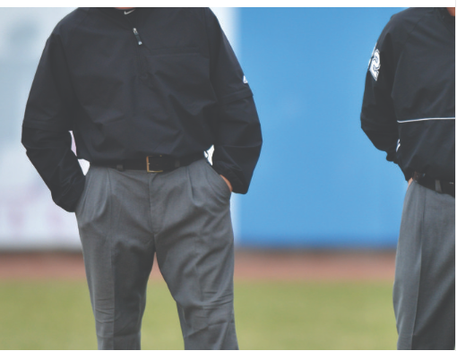
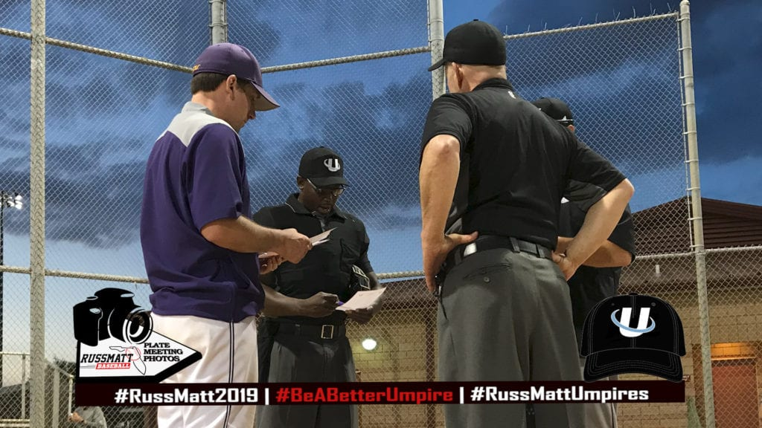
Elements of Successful Game Management?
Communication;
Nonverbal communication can in fact be the most important part of communication.
Umpires are more often perceived by their body language than by their words.
Body language usually sets the tone when a problem arises.
One of the best communication tools is our signals. Signals should be clear, distinct and meaningful, for all to understand. A strong and accurate signal says that I saw the entire play and made the correct call
Notes:
Body language usually sets the tone when a problem arises. The way you are perceived by a player or coach will influence what they are thinking.
Maintain eye contact with the coach or player during the discussion, and this will add to a more positive response. Remain calm, not confrontational when addressing an issue.
The less personal conversation we have with the participants, the fewer issues we will have if a situation arises. Umpires can and should develop open lines of communication with players and coaches but remain cautious as those casual conversations can be misinterpreted.

Slide 16
Elements of Successful Game Management?
Preventative Umpiring;
The ability to prevent an issue from happening by anticipation coupled with an accurate explanation.
Understanding the flow of the game, the tenor of the game, and what players natural reactions will be.
Notes:
Ask the question, what is PREVENTIVE UMPIRING & get about 1 minute of feedback and either say what is on the slide or have one of the participants read it.

Slide 17
Elements of Successful Game Management?
Preventative Umpiring;
The flow of the game and potential problems between teams, coaches or spectators, require special attention from umpires. Typically, there are warning signs before situations escalate. Recognize the warning signs and step in to diffuse them before they escalate.
Umpires must be aware of the possibility that, at the conclusion of a play, a call may be questioned. To remain calm in the face of adversity is an essential plan of an umpire’s make-up. Coolness must not be confused with complacency. It must be expected that there will be disagreements during the course of a competitive ball game. The closer the call, the greater the liklihood that a player or coach will have something to say.
Notes:
Talking point. Have participate read

Slide 18
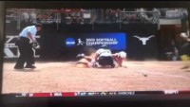
Texas vs Oregon

Slide 19
Elements of Successful Game Management?
Preventative Umpiring;
Many of us forget how a coach has a moral obligation to defend his/her players or their actions. To request an interpretation of a rule is not to question the umpire unnecessarily. Do not interpret questioning as a personal attack. Remember, they can’t argue or question judgement, they can question or argue rule interpretation or improper mechanics they felt may have contributed to the call. An umpire must be ready to respond to legitimately raised points of the rules. To clarify a coach’s misunderstanding of a rule quickly and concisely requires a thorough knowledge of the rules. In addition, it must involve some understanding of the questioners role in the game. Discussion on calls with Head Coach only!!
Notes:
Talking point. Have participate read

Slide 20
Elements of Successful Game Management?
Experience;
The knowledge and skill that is gained through training, practice, time spent umpiring and observing umpires resulting in a superior understanding of the game.
Experienced is gained by;
Being “a student of the game”,
Reviewing rule book, mechanics manual, and any additional training available
Notes:
Ask the question, what does experience have to do with game management & get about 1 minute of feedback and either say what is on the slide or have one of the participants read it.

Slide 21
GAME MANAGEMENT - PREGAME
Preparation
Prior to Game Comunications
Site Arrival
Proper Uniform
Partner Pregame “Here’s what I’m working on today”
Field Review
Coaches and Captains Plate Meeting
Notes:
Ask the question, what does preparation have to do with game management & get about 1 minute of feedback and either say what is on the slide or have one of the participants read it.
Preparation – What are you going to allow Coaches, Players to do. New Rules, etc.,
Site arrival - Arrival early. Check in with your partner when you arrive.
Partner Pregame – Set and Share game goals – Review New Rules/Ground rules/special rules, Flyball coverage, tag up responsibilities, umpire to umpire signals, requesting help from partner & situations.
Field and Equipment Inspection -
Plate Talk

Slide 22
GAME MANAGEMENT – Plate Meeting
Set the tone- Sportsmanship
Eye Contact
Handshake
Introductions
Lineups
Athletes legally and properly equipped
Ground rules
Notes:
Ask what kind of things you do or you might do at coaches meeting (since some are new to umpiring)?
What kind of things can be affected during the coaches meeting.

Slide 23
GAME MANAGEMENT - DURING GAME
Each pitch/play is an opportunity to gain experience in game management and focus
What is your verbal and non verbal communication saying about your management skills and commitment to the game?
AGAIN: Ignoring poor sportsmanship and rule violations only promotes them and makes it difficult to manage future games.
Notes:
What kind of things can affect GM during the game. What things do the umpires “own”? Keep in mind the next few slide

Slide 24
GAME MANAGEMENT - DURING GAME
Working with, Managing, Dealing with Coaches
Keep them in their designated areas
Offense – Base Coaches Box
Defense – In the Dugout
They may request time:
Conferences
Confer with umpire that made the call
Approach, Listen, Decide if they have earned a warning, Listen for one or more of the “Three P’s”, make sure there is a question, do not go for help unless they have created a doubt that you may have missed an element of the play. Be ready to explain why you are not going for help. Keep it short and succinct. Address the issue but do not allow it to delay the flow
Notes:
What kind of things can affect GM during the game. What things do the umpires “own”? Keep in mind the next slide

Slide 25
GAME MANAGEMENT - DURING GAME
Time Management
60 seconds from the last out
Warm up pitches
Batter, keep a foot in the box
Tactics that hasten or delay the game,
Tie Breaker,
Get the correct runner on 2B
Notes:
Ask how they we can manage the time management portion of the game. Debrief 1 minute

Slide 26
GAME MANAGEMENT - DURING GAME
Exit Strategy
Post Game
Use game notes
Time to teach/learn, evaluate performance
Invest for future improvement
Notes:
What kind of things can affect GM during the game. What things do the umpires “own”? Keep in mind the next few slide

Slide 27
GAME MANAGEMENT
Difference Between 1A and 5A?
Difference between conference play district play & state championship play?
Notes:
Ask if there could be a difference between each question above and how we manage it?

Slide 28
QUESTIONS

